Slide 1
Week 12 –
Final Presentation
By:
Dennis Tan Yong Jung – 221726Z
Teo Xue Ling Sharlene – 221429U

Slide 2
Table of contents
01
02
03
04
Project Background
Wireframe
Features & Challenges Faced
Improvements made

Slide 3
01
Project Background

Slide 4
Project background
The project aims to enhance the visitor experience during the campus Open House event by integrating innovative technology solutions.
This mobile-friendly application will allow visitors to participate in various activities via a user-friendly digital interface. It will also enable booth helpers to effectively manage the queue system while visitors engage in their activities.
Notes:
Our project focuses on improving the visitor experience during the campus Open House by leveraging innovative technology. We are developing a mobile-friendly application that allows visitors to easily participate in different activities through an intuitive digital interface. Additionally, the app helps booth helpers efficiently manage the queue system, ensuring a seamless experience for both visitors and booth helper.

Slide 5






Technologies Used
Visual Studio Code
React JS
Node JS
MySQL
Figma
Azure Devops
Software Tools:
AWS Websocket
AWS Lambda
Notes:
Websocket – real time updating from the backend and frontend of the website.

Slide 6
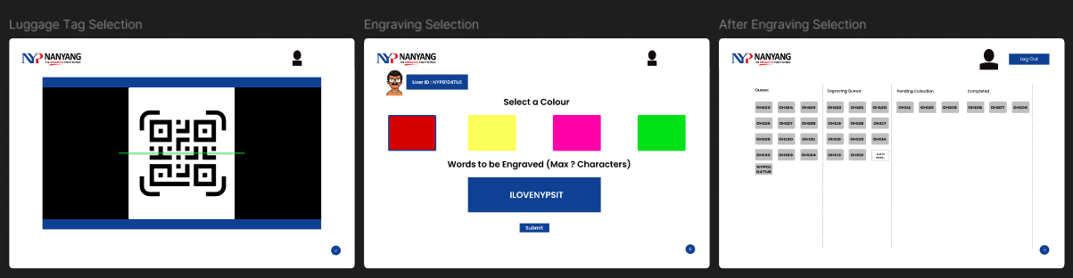
Wireframe (Engraving Selection)

Slide 7
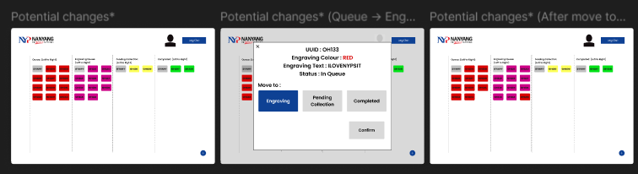
Wireframe (Admin Queue)

Slide 8
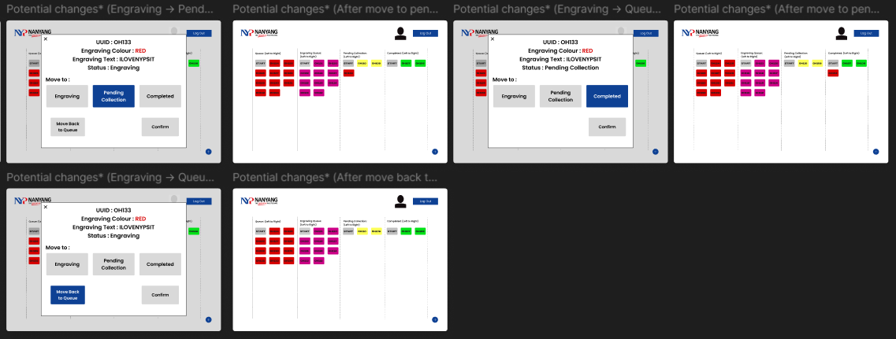
Wireframe (Admin Queue)

Slide 9
03
Features and Challenges Faced

Slide 10
Features
Features that we have coded:
QR Scanner
Scan user ID
Engraving Selection
Engraving Selection
Profanity Filtering
Luggage tag customisation
Queue Management System
Multiple Queues (Queues, Engraving, Pending Collection and Collected)
Search function
CSV Export Function
Sub-tabs in “Collected” Queue

Slide 11
Challenges
Challenges:
Unable to connect to websocket due to inexperience
UX/ UI issues
Queue was not able to show more than 4 ticketId originally
Hard to go back to the queue when in the engravingSelection
Large quantities of data in the Collected queues after each day
Hard to tell which ticketId was what colour of luggage tag
Hard to locate where each ticketId was in the queue
No way to tell what is the error when moving to wrong queues

Slide 12
04
Improvements made

Slide 13
Improvements made
Improvements:
Search ticket id function
CSV Export function
Have a report of what was engraved and timing
Show total number of tickets in each queue
Timestamp in the ticket
FIlter out profanity languages
Show all/ today button for the “Collected” column
Added vertical lines to visually divide each queue
Added a back button from the engravingSelection to back to the queue
Visually change the background of each ticketId in the queue to reflect the colour of the luggage tag
Added specific error messages for the various queues
Notes:
Search function – provide convenience for the booth helper when they want to search for a specific ticketID especially when dealing with large num of ticketID.
Csv export function – admin to export and use the data for future analysis / reporting.
Ticket count – admin to see an overview of the volume of tickets in each column. Better manage their workload.
Timestamp – admin to check when the ticket first joined the queue.
Profanity filtering – detects and removes inappropriate words before submitting engraving form
The rest is the UI, which to make it more visually appealing

Slide 14
Learning Outcome
What we have learned:
Learned how to troubleshoot issues
Learned importance of UI and the designing
Learned more in depth in:
ReactJS
SQL Statements
Learned about Backend/ Database Skills:
Fetching and handling data from APIs
AWS Lambda & Websocket
Soft Skills:
TIme Management Skills
Adaptability
Problem solving
Pair Programming:
Have more ideas when brainstorming
Notes:
We’re now able to debug and troubleshoot the errors we faced. And gain a deeper understanding of ReactJS and improving our ability to build dynamic and responsive user interface. We also enhanced our proficiency with SQL statements for better database performance.
We also learnt some backend/ database skills: - such as fetching and handling data from the APIs, integrating real time data into our application. And also learn more about the using a serverless compute service such as AWS Lambda.
Soft skills: - time management – ensure we complete it within the timeframe.
- adaptability – the coding language was foreign to us and we had to learn a new language.
- problem solving – had to debug and solve the errors faced
- pair programming – fostered better communication and innovative ideas

Slide 15
THANK YOU

